Slide 1

Logistical notes
Vaccines …?
Homeworks
Chapter 14 due today Monday!
Average completion time: 13mins
Talk to me if you’ve fallen behind on homework. Email, office hours; just talk to me. I’m receptive: I want you to be on track and getting things done, not overwhelmed by the volume of work, especially if it’s already piled up a bit.
It’s better to attempt the homework and get something wrong than to let days (and -10% per day) slip by
Exam corrections due to me/in my mailbox by Friday at 5pm!

Slide 2
Math/significant figures
Chapter 14 homework asks questions about…
how long the Sun could burn
You’re given how much energy it has per unit mass
You know how much it radiates (Luminosity: Watts (aka J/s))
how much mass the Sun loses due to fusion
You’re told to assume its luminosity is constant
You’re told the lifetime is 10 billion years
You know its luminosity
Use E=mc², rearranged, to calculate mass
Significant figures:
Any non-zero integer is significant (1, 2, 3, …)
Any digit expressing the limit in precision that you can measure is significant
Examples:
2.0 – 2 sigfig
0.02 – 1 sigfig
2000 – 1 sigfig
2000. – 4 sigfig
2x10⁶ – 1 sigfig
2.0300 – 5 sigfig
0.00203 – 3 sigfig
Notes:
Let me know if you already attempted this problem and had issues- I can adjust points up if you re-work it

Slide 3
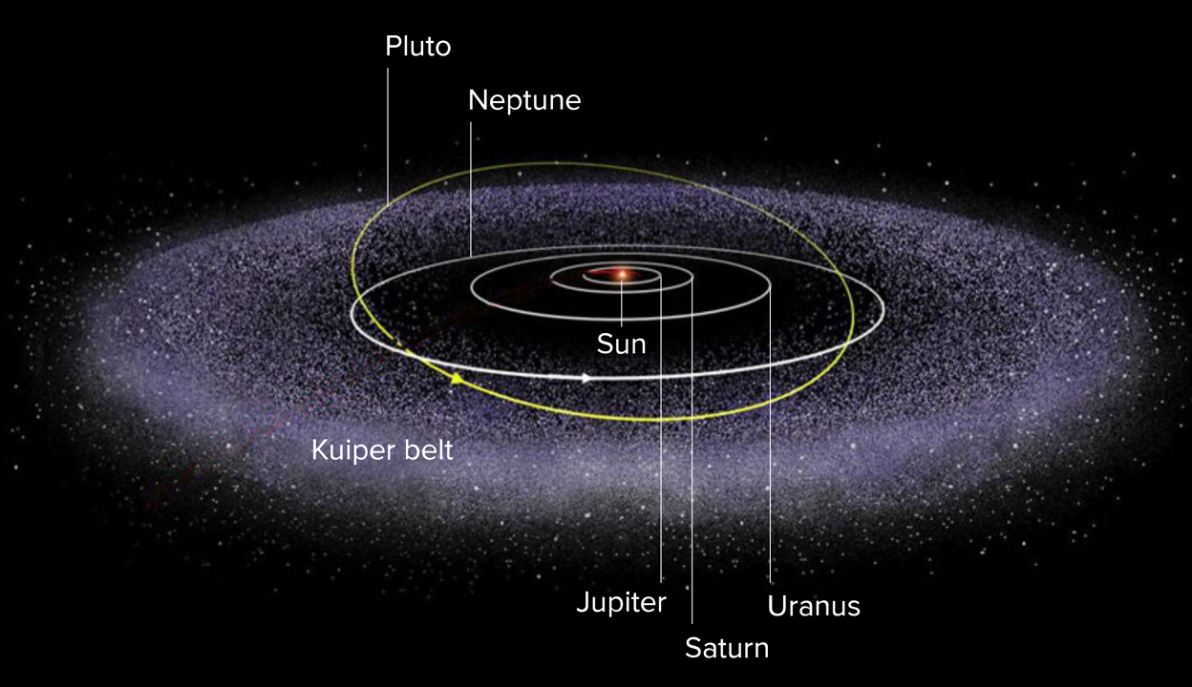
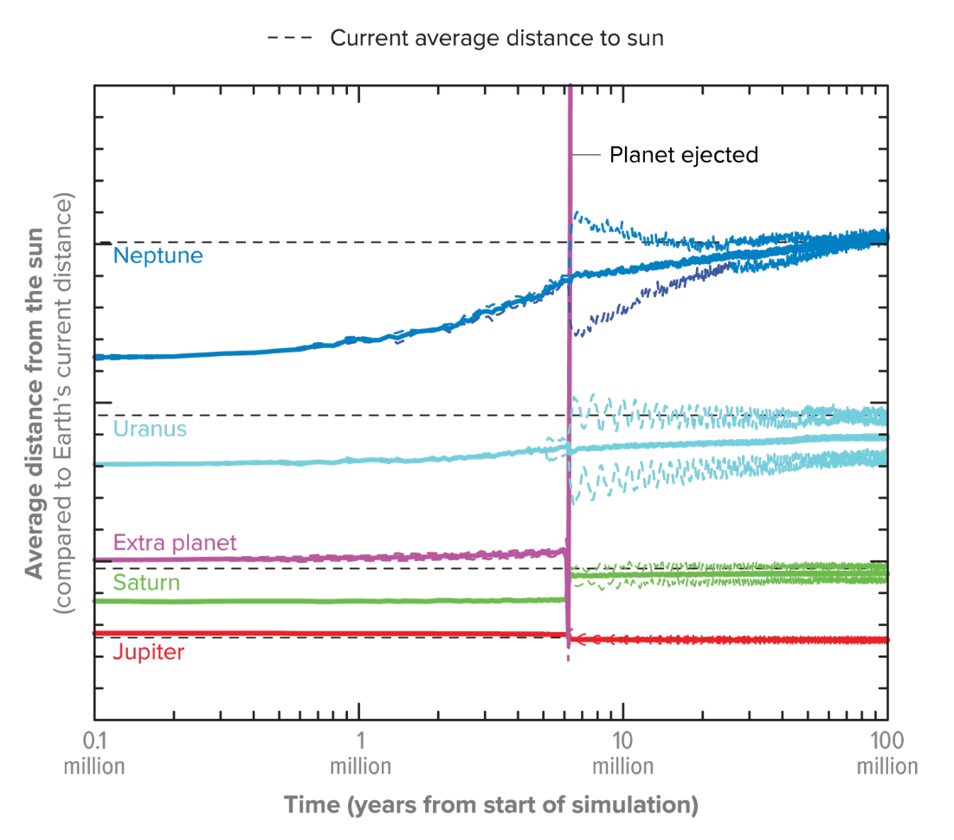
Today in science…
Planet X?
“Orbital Forensics Hint at Sun’s Long-Lost Planet”
Early orbital simulations ended with Uranus and Neptune being ejected
‘the problem is Jupiter, it’s a massive bully with far-reaching F_{g}’
Scientists created millions of randomized early solar systems, let their orbits evolve
Only 1% of the time would planets settle into orbits as we know them today
Scientist David Nesvorný tried adding “martyr planets” to be main recipient of orbital energy from Jupiter and ejected
Notes:
https://www.scientificamerican.com/article/orbital-forensics-hint-at-suns-long-lost-planet
Simulate your own outer planets!
http://lasp.colorado.edu/education/outerplanets/orbit_simulator/

Slide 4
Surveying the stars
Chapter 15, The Cosmic Perspective
Notes:
Melotte 15

Slide 5
The H-R diagram
Rosenberg, Hertzsprung and Russell were working on this around the same time.. 1910, 1911, 1913
Plotting spectral lines indicative of temperature against stars’ apparent magnitudes, absolute magnitudes, and eventually, luminosities
Shows a relationship between fundamental stellar properties: temperature and brightness
Note to Alicia: don’t forget to do H-R Diagram demo here.

Slide 7
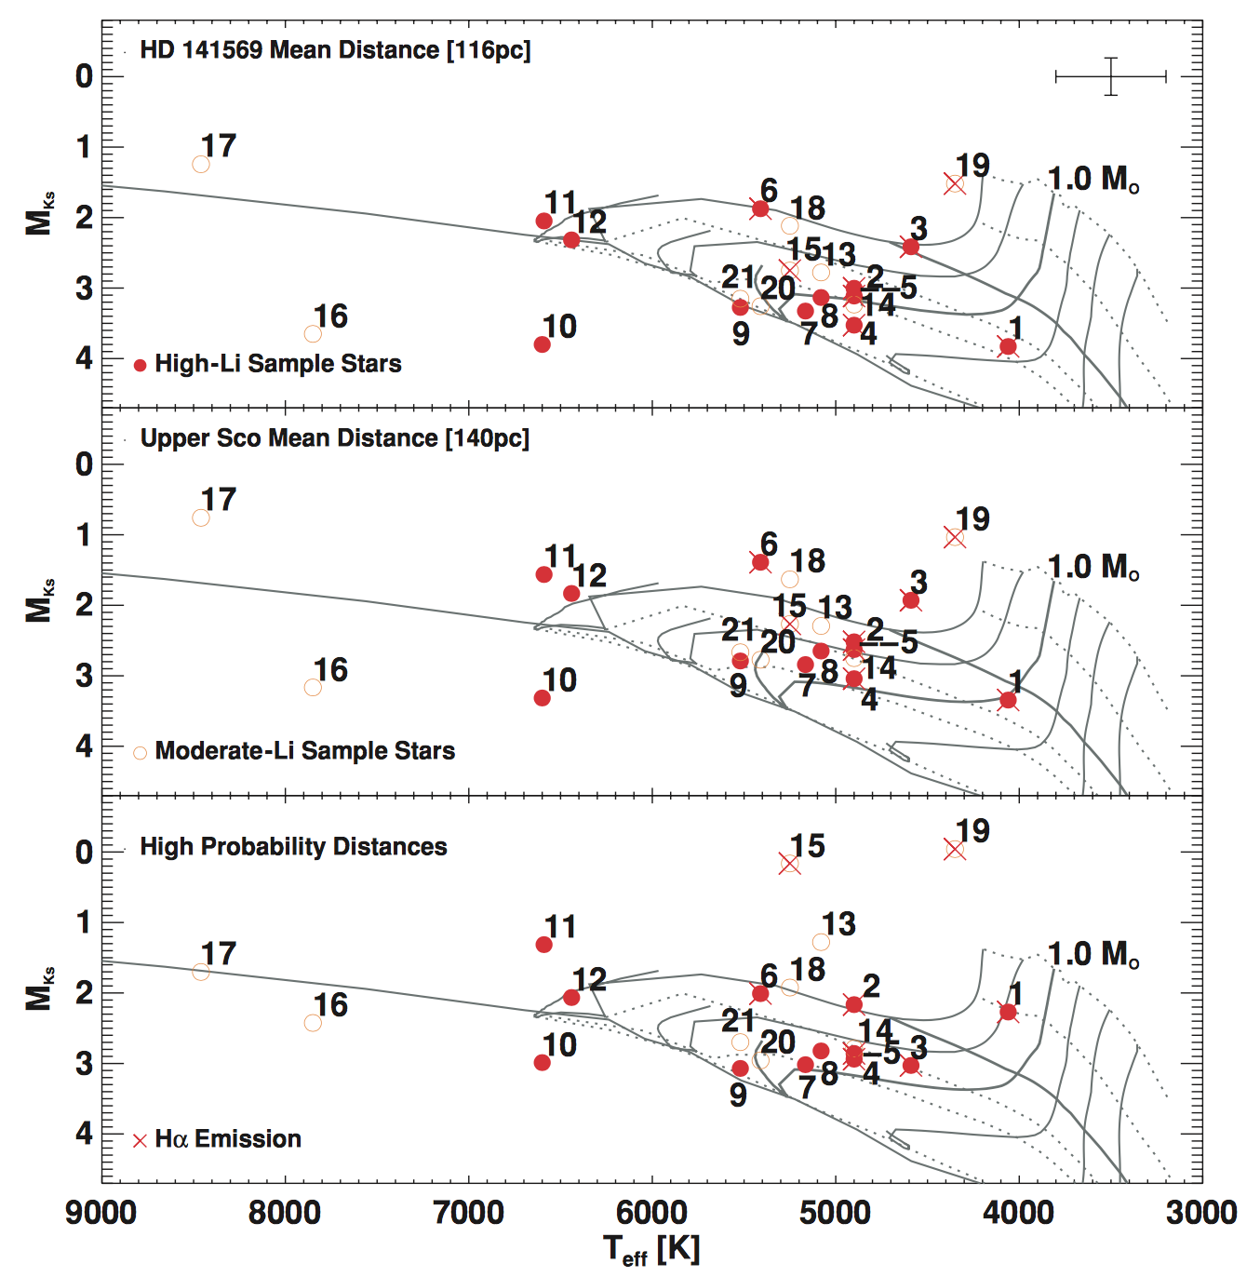
Notes:
This is a figure from my first paper where I made a H-R diagram for a group of stars I didn’t know the distance to.

Slide 8
What is the H-R diagram really telling us?
Almost everything, tbh.
Once brightness is corrected for distance, intermediary effects, H-R diagram can tell us:
Stellar temperature
Stellar radius
Stellar mass
Stellar age
Is this easy to measure/model? No! But ideally, yes- you can get all of this information out of the H-R diagram

Slide 9
What is the most fundamental stellar property?
What determines everything about a star?
How long it lives (fuses at its core)?
How hot its surface gets?
Its radius and brightness?

Slide 10
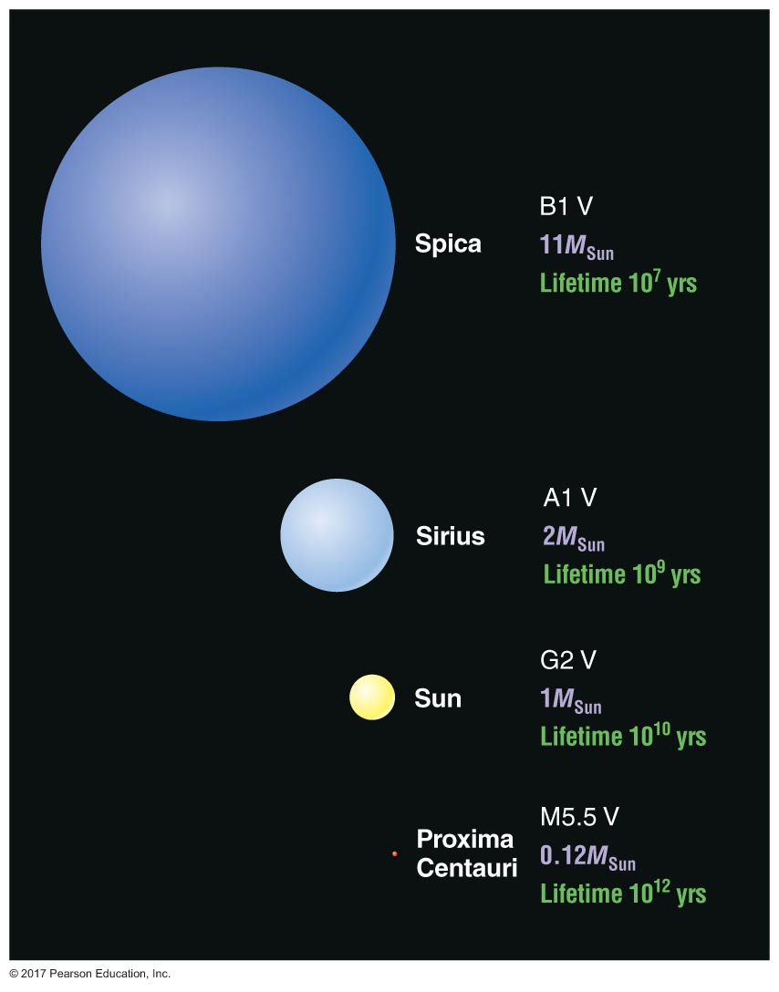
What is the most fundamental stellar property?
What determines everything about a star?
How long it lives (fuses at its core)?
How hot its surface gets?
Its radius and brightness?
Its mass!

Slide 11
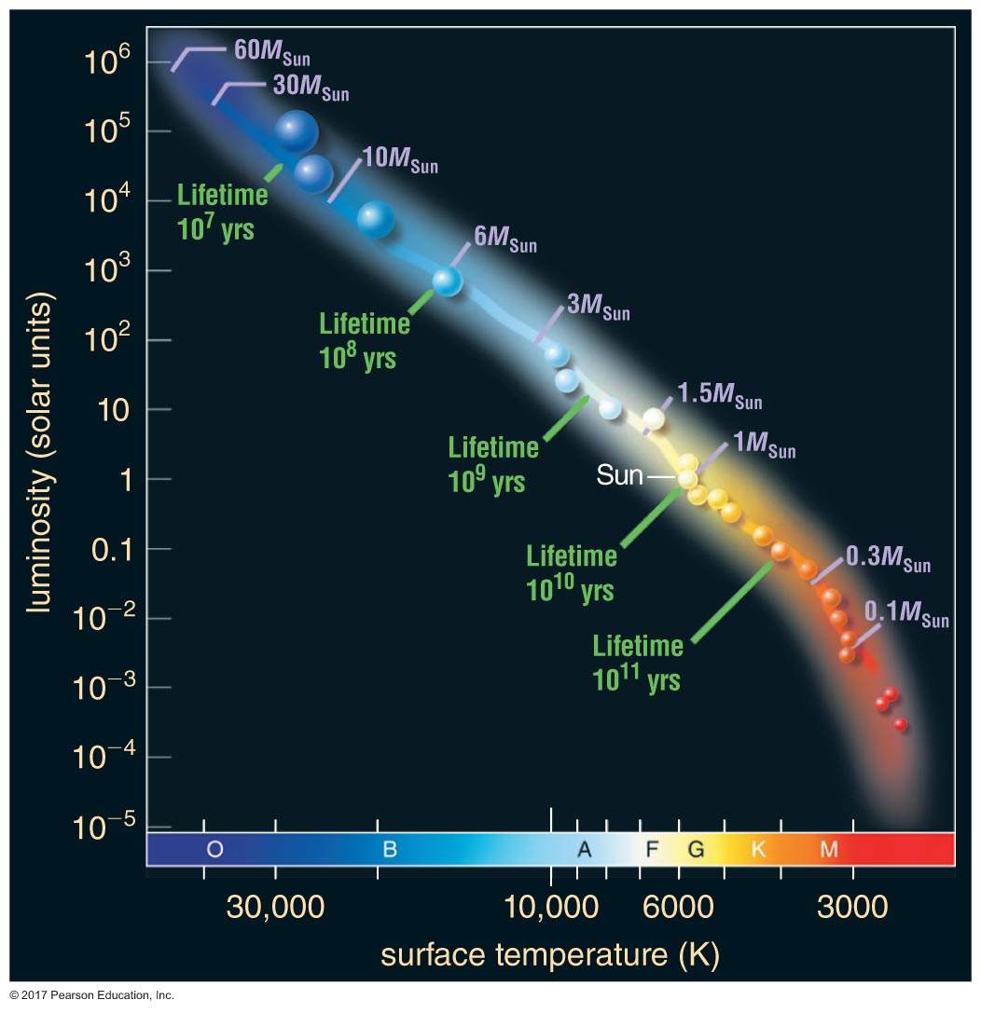
The main sequence
Stars on the main sequence are burning H in their cores
Stars of different masses have both varying amounts of H to burn, and different rates of burning
This leads to different lifetimes
Very massive stars are rare!
The most massive stars have the shortest lives

Slide 12
The main sequence
Stars on the main sequence are burning H in their cores
Stars of different masses have both varying amounts of H to burn, and different rates of burning
This leads to different lifetimes
Very massive stars are rare!
The most massive stars have the shortest lives
And yet.. They play a very important role in stellar evolution and the chemical enrichment of the universe

Slide 13
After the main sequence…
Giants and Supergiants
Cooler and more luminous than the Sun (larger radii)
Nearing end of their lives: H fusion has ended, trying to fend off F_{g}
Will talk about more in chapter 17…
White dwarfs
What’s left after a Giant or Supergiant poofs off its outer atmosphere
About Earth-sized, but ~Solar mass
No energy source, so they just cool into eternity

Slide 14
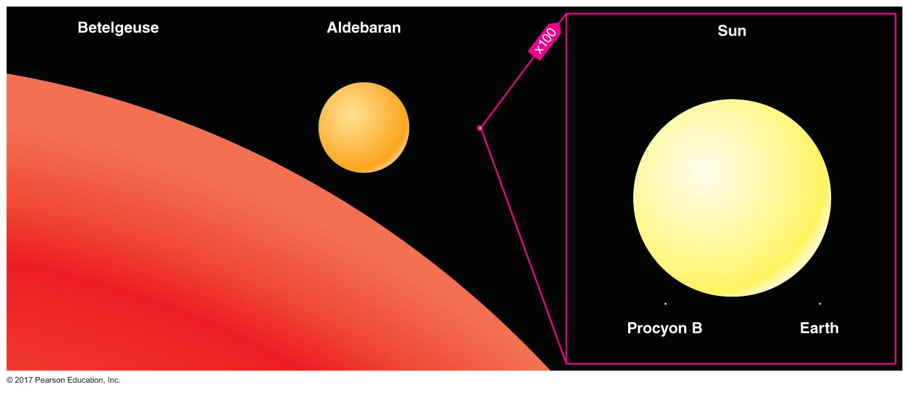
Size scales: Supergiants, Giants, the Sun, red dwarfs, the Earth

Slide 15
After the main sequence…
What happens when stars run out of H?
Gravitational equilibrium lost: can have pulsations, variability
Recall: fusion reactions decrease the numbers of light elements in the core of a star
Proton-proton chain no longer functions
Heavier elements start to fuse
Reactions begin in outer layers of star: instabilities develop
Notes:
https://www.sheffield.ac.uk/physics/teaching/astronomy/hicks_telescope/hicks_observatory_pics

Slide 16
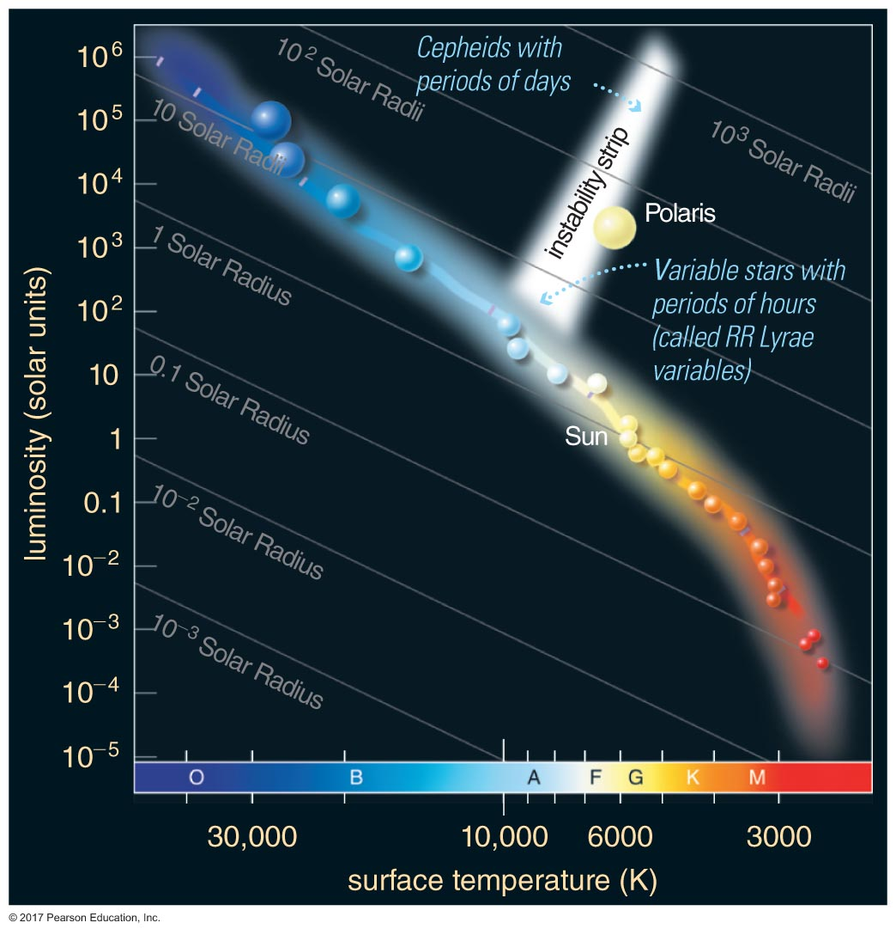
After the main sequence…
Variable stars: their luminosity, as the name implies, varies with time!
Categories of pulsating variable stars, depending on period of luminosity changes:
Delta Scuti (minutes-hours)
RR Lyrae (hours)
Cepheids (days-weeks)
What are other forms of variability we’ve talked about?
Eclipsing binaries
Spotted stars

Slide 17
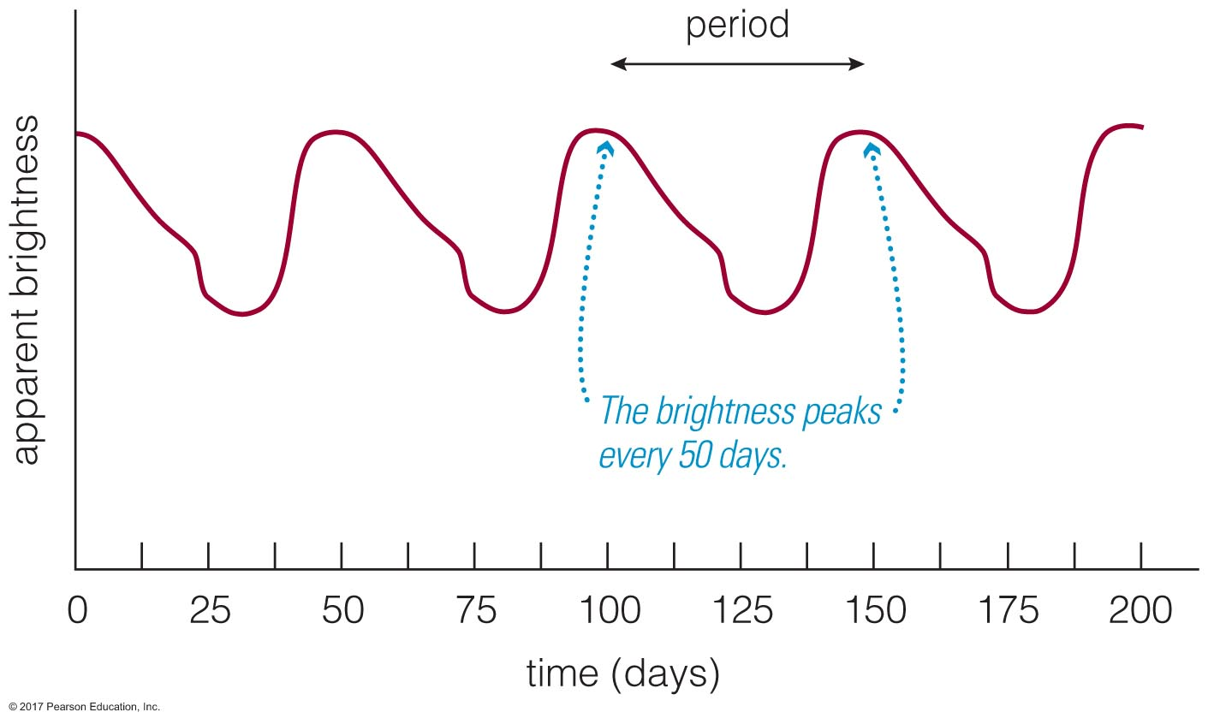
Cepheid Variables
Discovered by Henrietta Swan Leavitt
What’s the big deal with these stars?
They are really bright
Like, seriously really bright--we can see them in other galaxies, they’re that bright
Weirdly, their pulsation periods are related to their luminosity
Remember: Luminosity is the star’s inherent brightness—distance independent!
We’ll learn more in Chapter 20…

Slide 18
Star clusters
Remember how sun-like stars born from cloud of gas and dust?
More than one star can be born in one of these clouds, depending on its size and mass distribution!
Entire star-forming regions are observed
Clusters of stars of various ages:
Associations and moving groups (very young)
Open clusters (main sequence-ish and older)
Globular clusters (very old)

Slide 19
Clusters in the Milky Way
We think the Milky Way is shaped kind of like a UFO…
The flat part is called the disk
The middle part is called the bulge
The parts away from the plane of the galaxy are called the halo
Different parts of the galaxy are thought to be different ages, possibly due to how the Milky Way formed
Stars in the Milky Way form and evolve in clumpy structures (the Milky Way’s spiral arms)
Stars in clusters are gravitationally bound to the center of mass of the cluster: orbits can be complex, depending on how dense the cluster is!

Slide 20
Open clusters
Open Clusters are
younger, always found in the galactic disk
less densely packed (~few 1000 stars)
typically about 30 ly across
example: the Pleiades (aka Subaru...)
Notes:
http://intothenightphoto.blogspot.com/2014/07/finding-milky-way-with-sky-guide.html

Slide 21
Open clusters
Open Clusters are
younger, always found in the galactic disk
less densely packed (~few 1000 stars)
typically about 30 ly across
example: the Pleiades (aka Subaru..., aka the Seven Sisters)
Several 1000 stars, we can see about 6 of them
Looks like a wee tiny dipper
About 100 Myr (million years) old
Notes:
Subaru also means ‘unite’ in addition to referring to the constellation known as pleiades

Slide 22
Globular clusters
Globular Clusters are
older, found in the galactic halo
can have >1,000,000 stars!!!
typically 60-150ly across
planets in this cluster would likely have lovely nights
densely packed=lots more very, very nearby stars
Milky Way would possibly take up bigger segment of night sky
Notes:
https://en.wikipedia.org/wiki/Globular_cluster – M80 (top)
http://www.apod.nl/ap100527_nl.html -- M13 (bottom)

Slide 23
Star clusters
How do we know how old a cluster of stars is?
Notes:
Compare the pictures here of the open and globular clusters… what pops out at you right away?

Slide 24
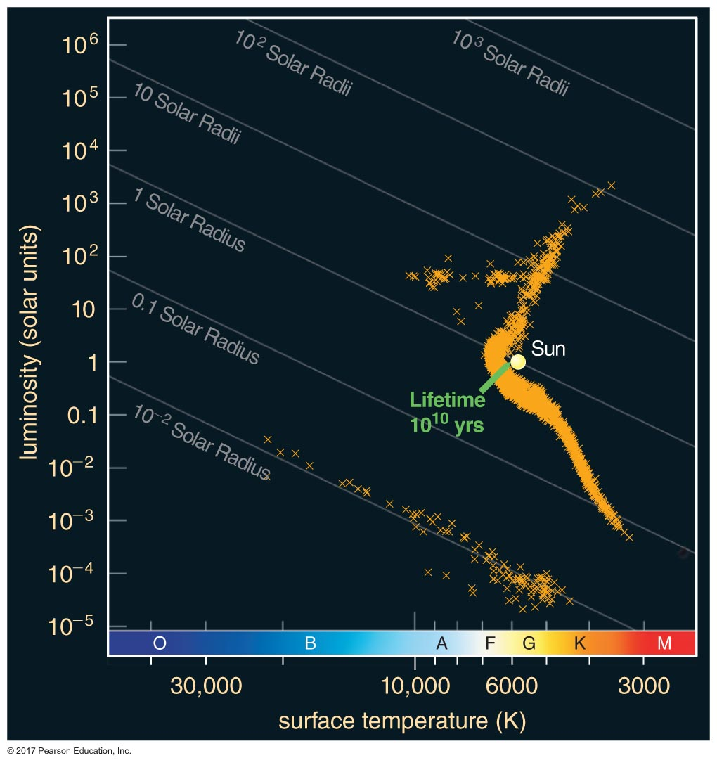
Star clusters – age
How do we know how old a cluster of stars is?
Where they are on the H-R diagram
For young clusters, elements in the stars themselves (Lithium)
Notes:
Compare the pictures here of the open and globular clusters… what pops out at you right away?

Slide 25
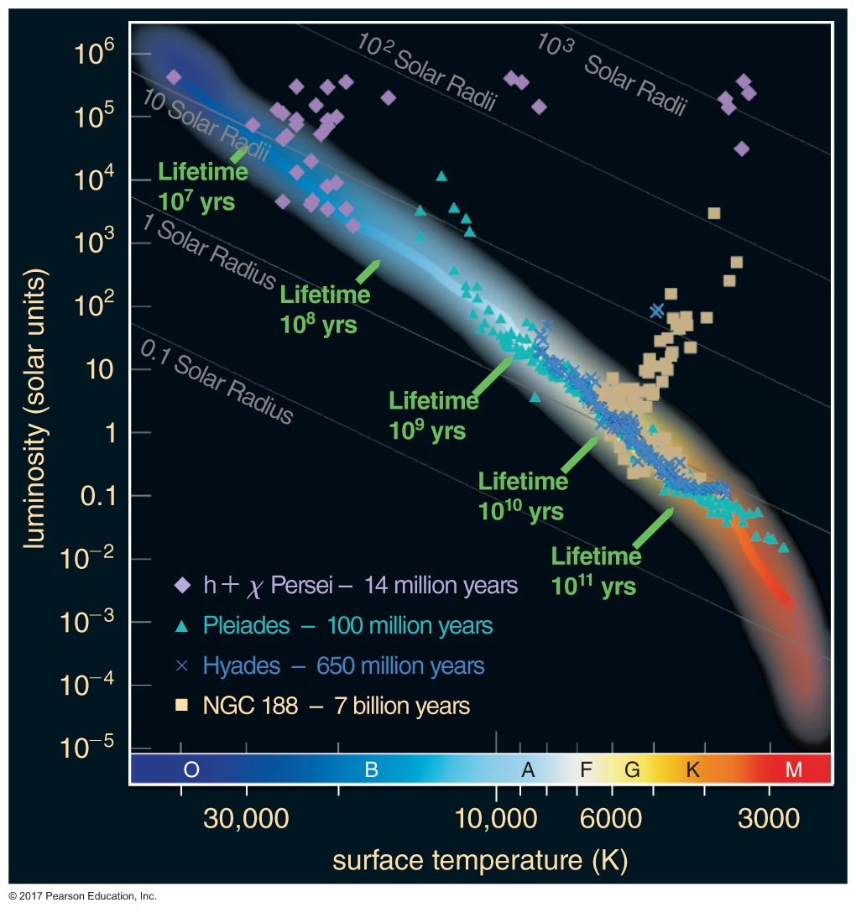
Star clusters – age
Open Clusters
Globular Cluster ~10¹⁰yrs

Slide 26
The birth of stars
Chapter 16, the Cosmic Perspective
Notes:
The orion nebula cluster https://www.eso.org/public/images/eso1723a/

Slide 27
Notes:
The orion nebula cluster https://www.eso.org/public/images/eso1723a/

Slide 28
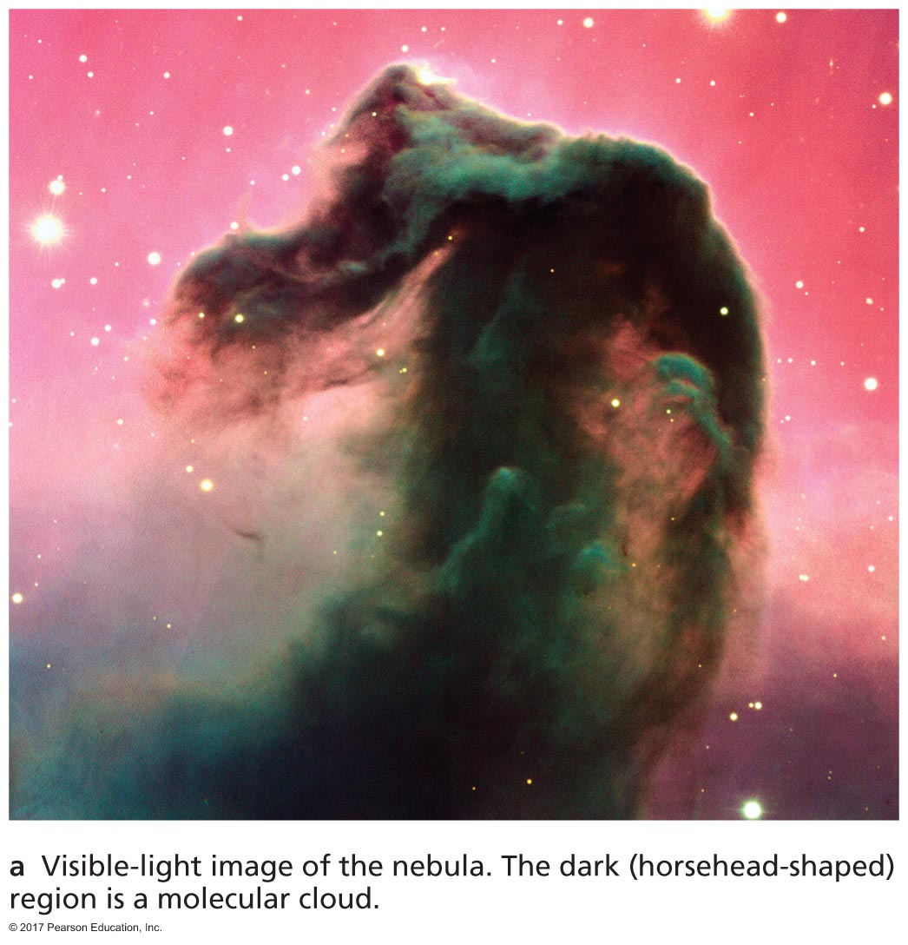
Stellar nurseries
We use imaging to put stars onto the H-R diagram
The H-R diagram shows us stellar ages, the imaging shows the youngest stars are near dark clouds of gas and dust
…are they really dark?

Slide 29
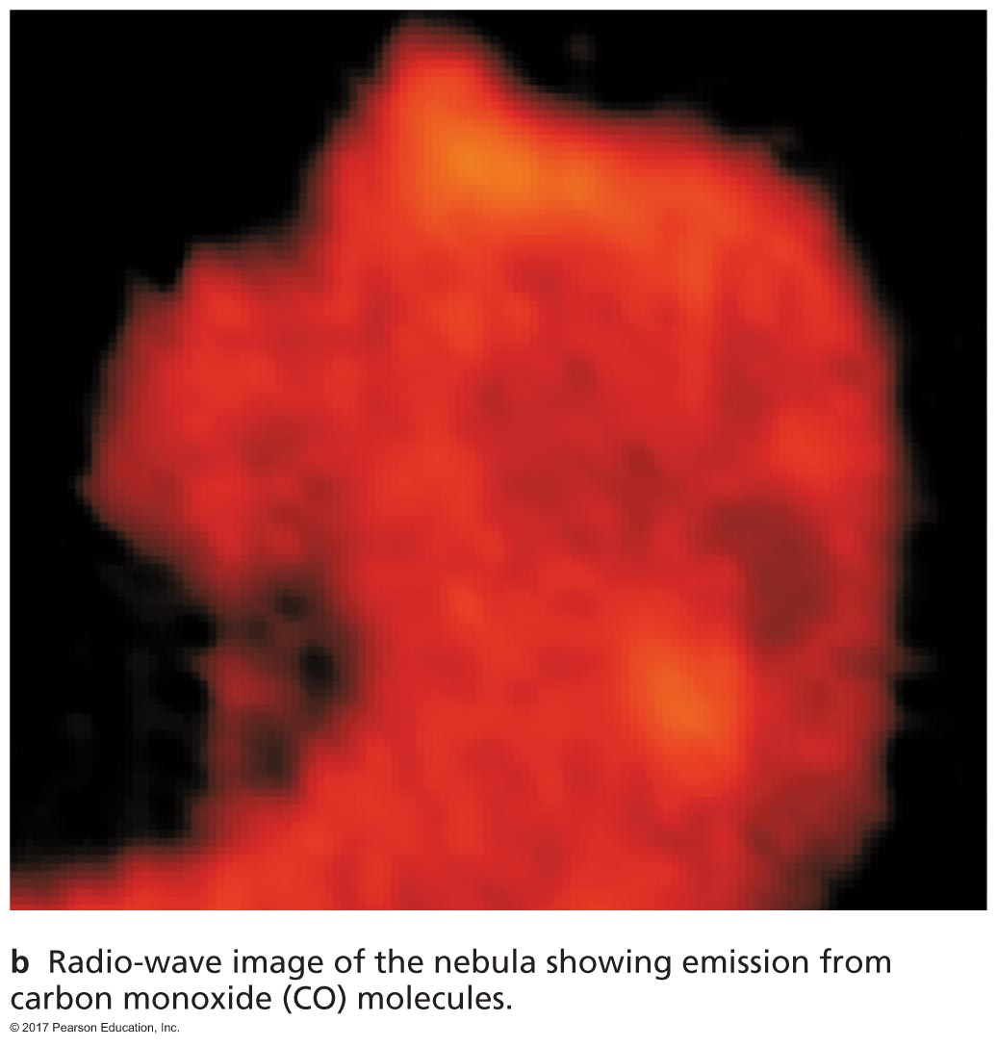
Stellar nurseries
We use imaging to put stars onto the H-R diagram
The H-R diagram shows us stellar ages, the imaging shows the youngest stars are near dark clouds of gas and dust
…are they really dark?
not necessarily!
Cold clouds, 10-30K
aka ‘molecular’ because
not enough energy to be
ionized
Notes:
Depends on the wavelength you’re observing. The material in the horsehead nebula is dense and cool compared to the background radiation- it absorbs visible light, but itself emits in radio wavelengths.

Slide 30
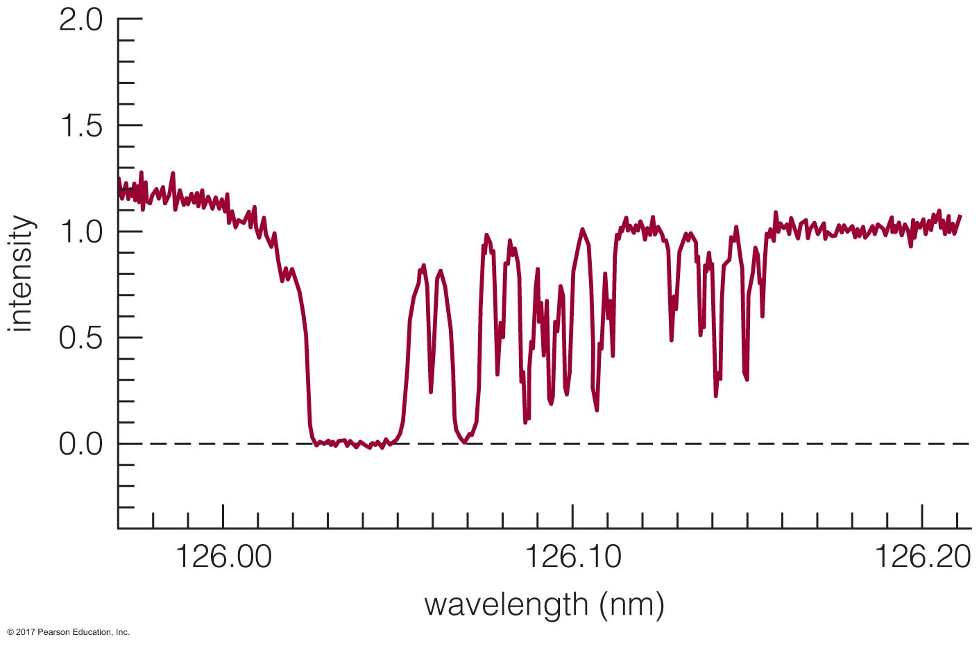
The interstellar medium
The space between stars is called the interstellar medium (ISM)
It’s a near perfect vacuum by Earthlings’ standards, but no- not entirely empty
How do we know? It gets in the way of stars!
The ISM contains both gas and dust
The ISM impacts observations of lone stars
The ISM+molecular cloud along the line of sight between us
and a forming star make them very hard to observe!

Slide 31
Interstellar reddening
Dust grains affect the way light travels through a molecular cloud
Absorb or scatter the light
Makes regions appear almost black relative to background light
Processes are wavelength dependent:
Bluer light is more readily scattered or absorbed, so objects appear more red than they actually are → called reddening
Reddening is a pain, but can be useful: if we know what the actual light source is, we can use reddening to figure out how much dust and gas are along our line of sight

Slide 32
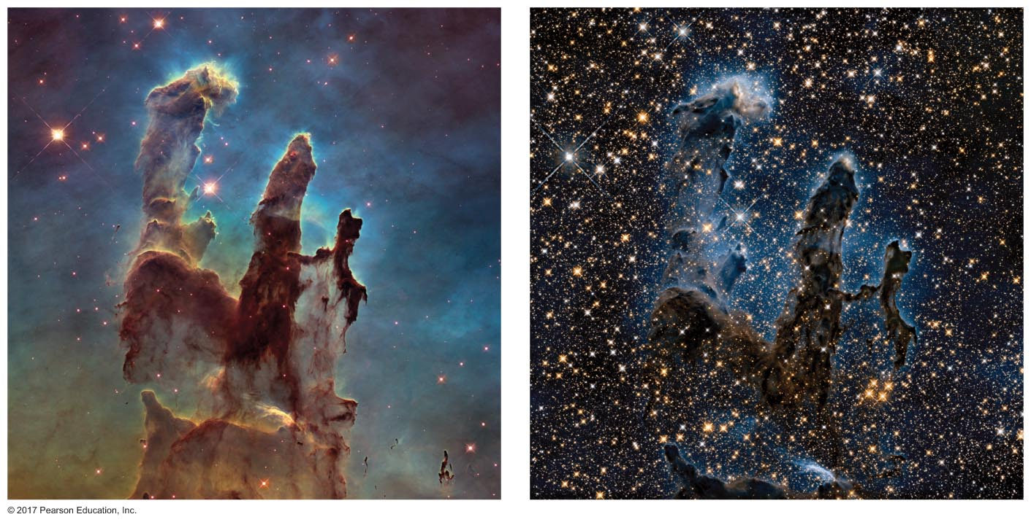
Multi-wavelength imaging
Longer wavelengths pass through gas and dust more easily than shorter wavelengths
Notes:
Visible light vs infrared light

Slide 33
Why do stars form?
Gas and dust of a certain temperature have a pressure due to the kinetic energy of the atoms/molecules/grains
Pressure depends on the temperature and density of the cloud
This is called thermal pressure
In low density clouds, thermal pressure is enough to prevent collapse: not enough mass for strong F_{g}
If density is high and temperature low, thermal pressure isn’t enough; collapse will begin

Slide 34
Conservation of energy…
As gravitational potential energy is converted to thermal energy, molecular clouds will heat up and radiate away the energy
What would happen if they didn’t radiate the energy away?
Thermal pressure would increase, stopping collapse
Radiation in infrared, radio, keeps cloud cool, gravity keeps working

Slide 35
Star formation: wrinkles and mysteries
We see stars forming only in molecular clouds that are ~1000s of times more massive than the Sun
Molecular clouds show lots of motion: turbulence, like wake of a boat in water
Need a lot more mass to overcome turbulence than thermal pressure
We also see that molecular clouds have magnetic fields: light from behind them travels through and is polarized
What is the role of the magnetic field in star formation?
Remember magnetic fields interact with charged particles.. In a cold cloud, not a lot of these, but enough to interact with field, and for them to interact with neutral particles
Enough to possibly slow or halt gravitational collapse

Slide 36
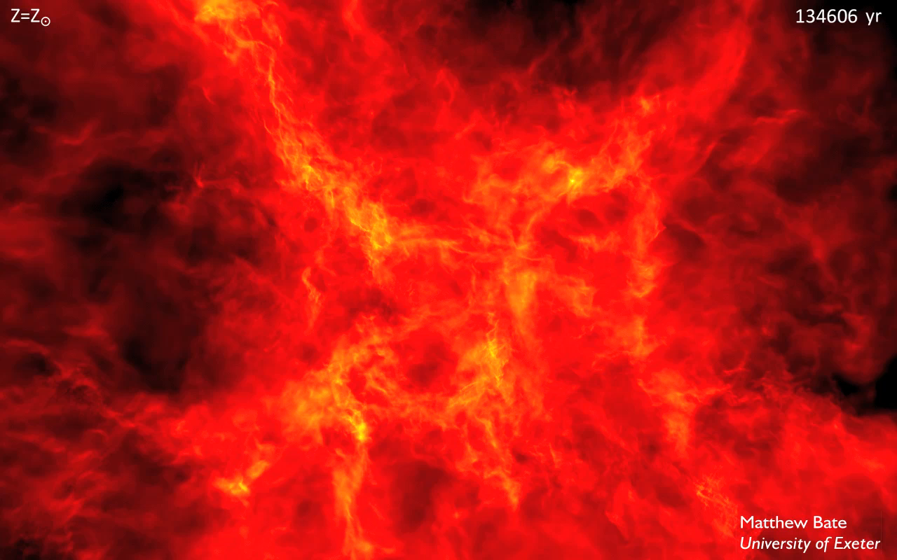
Notes:
https://www.astro.ex.ac.uk/people/mbate/Cluster/cluster500RT.html
The calculation models the collapse and fragmentation of a 500 solar mass molecular cloud that is 0.8 pc in diameter (approximately 2.6 light-years). At the initial temperature of 10 K with a mean molecular weight of 2.38, this results in an thermal Jeans mass of 1 solar mass. The free-fall time of the cloud is 190,000 years and the simulation covers 285,000 years.
The cloud is given an initial supersonic `turbulent' velocity field in the same manner as Ostriker, Stone & Gammie (2001). We generate a divergence-free random Gaussian velocity field with a power spectrum P(k) \propto k⁻⁴, where k is the wave-number. In three-dimensions, this results in a velocity dispersion that varies with distance, lambda, as sigma(lambda) \propto lambda^{1/2} in agreement with the observed Larson scaling relations for molecular clouds (Larson 1981). This power spectrum is slighly steeper than the Kolmogorov spectrum, P(k)\propto k^{11/3}. Rather, it matches the amplitude scaling of Burgers supersonic turbulence associated with an ensemble of shocks (but differs from Burgers turbulence in that the initial phases are uncorrelated).
The calculation was performed using a parallel three-dimensional smoothed particle hydrodynamics (SPH) code with 35 million particles on the University of Exeter Supercomputer. It took approximately 6,000,000 core-hours running on up to 256 compute cores (16 compute nodes). The SPH code was parallelised using both MPI and OpenMP by M. Bate. The code uses sink particles (Bate, Bonnell & Price 1995) to model condensed objects (i.e. the stars and brown dwarfs). Sink particles are point masses that accrete bound gas that comes within a specified radius of them. This accretion radius is to set 0.5 AU. Binary systems are followed to separations as small as 0.01 AU - closer systems are assumed to merge (but no mergers occur in the calculation here).

Slide 37
What topics do you have questions on after today’s class?
What from today might have been unclear?
What would you like me to review next class?
Is there some question on your mind I haven’t answered yet?
Clicker free response question, anonymized polling

